Slide 1
L E C T U R E
10
Project Scheduling and Tracking
(continuing)
Notes:
This repository of slides is intended to support the named chapter. The slide repository should be used as follows:
Copy the file to a unique name for your course and unit.
Edit the file by deleting those slides you don’t want to cover, editing other slides as appropriate to your course, and adding slides as desired.
Print the slides to produce transparency masters or print directly to film or present the slides using a computer image projector.
Each slide includes instructor notes. To view those notes in PowerPoint, click-left on the View Menu; then click left on Notes View sub-menu. You may need to scroll down to see the instructor notes.
The instructor notes are also available in hardcopy as the Instructor Guide to Accompany Systems Analysis and Design Methods, 5/ed.

Slide 2
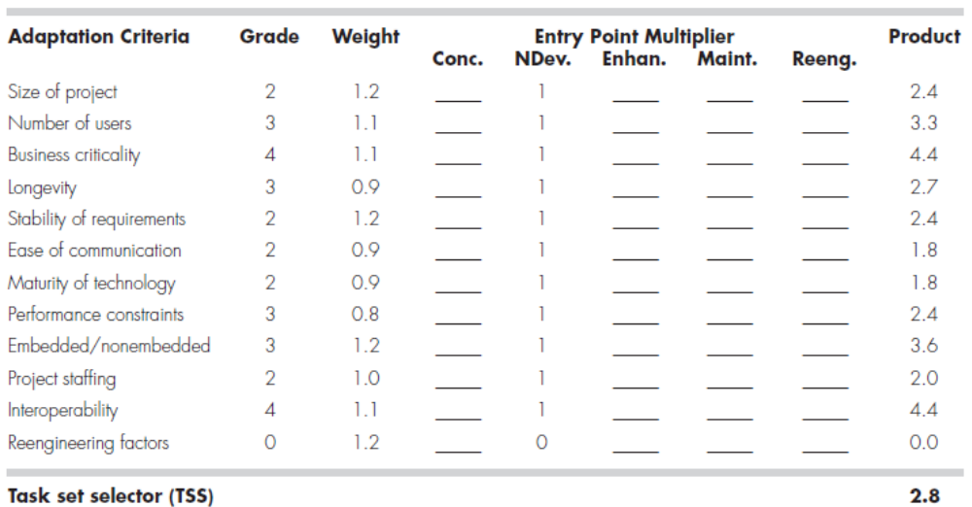
COMPUTING THE TASK SET SELECTOR—AN EXAMPLE
Recap from previous session)
http://groups.umd.umich.edu/cis/tinytools/cis375/f00/tss/Main_11291.html

Slide 3
SELECTING SOFTWARE ENGINEERING TASKS
In order to develop a project schedule, a task set must be distributed on the project time line.
The task set will vary depending upon the project type and the degree of rigor.
In some cases, one project type flows smoothly into the next.

Slide 4
SELECTING SOFTWARE ENGINEERING TASKS
As an example, we can consider the software engineering tasks for a concept development project.
Concept development projects are initiated when the potential for some new technology must be explored. There is no certainty that the technology will be applicable, but a customer (e.g., marketing) believes that potential benefit exists. Concept development projects are approached by applying the following major tasks: next slide

Slide 5
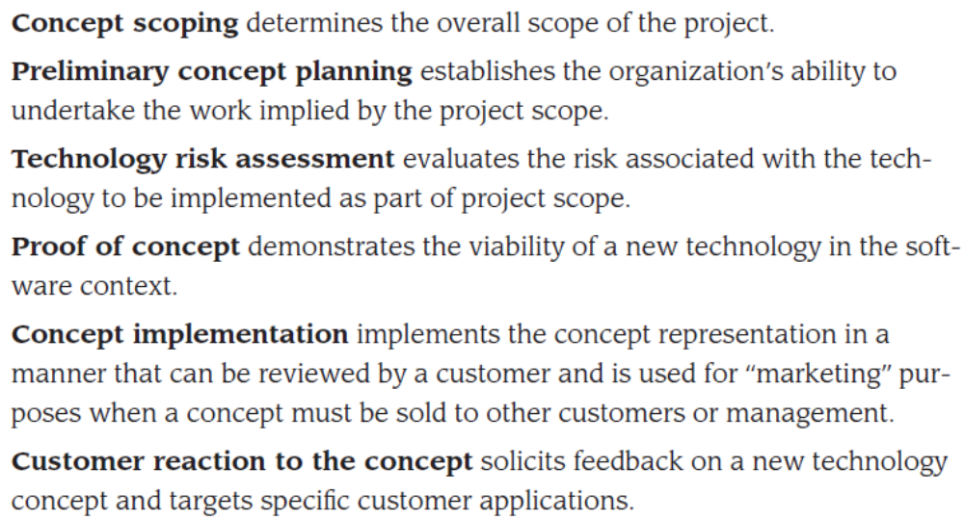
SELECTING SOFTWARE ENGINEERING TASKS

Slide 6
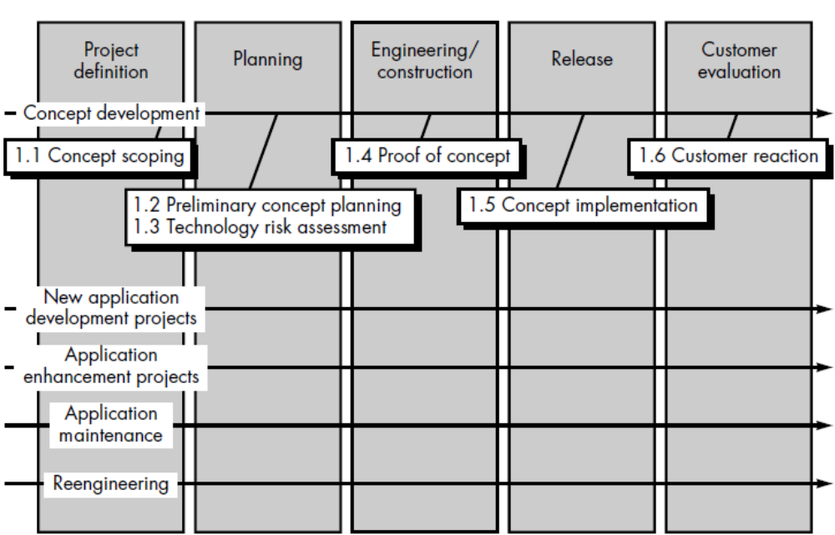
Concept development tasks in a linear sequential model

Slide 7
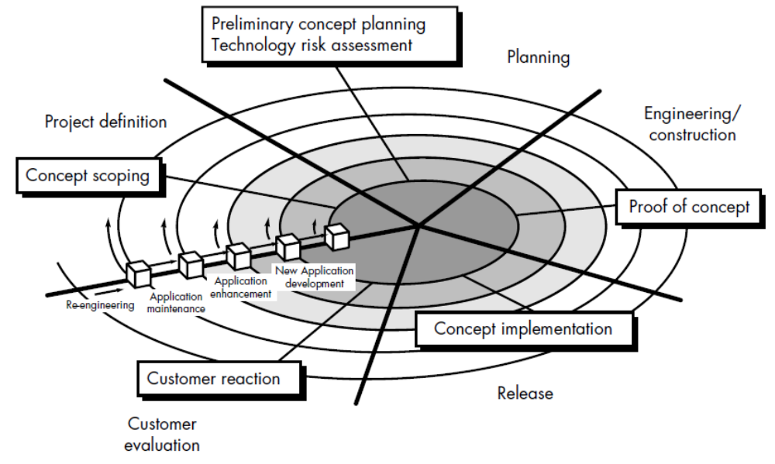
Concept development tasks using an evolutionary model
If an evolutionary model is chosen, the layout of tasks 1.1 through 1.6 would appear as shown in Figure. Major software engineering tasks for other project types can be defined and applied in a similar manner.

Slide 8
REFINEMENT OF MAJOR TASKS
Refinement begins by taking each major task and decomposing it into a set of subtasks (with related work products and milestones).
Task refinement can be accomplished using an outline format, a process design language approach is used to illustrate the flow of the concept scoping activity: (Next Slide)

Slide 9
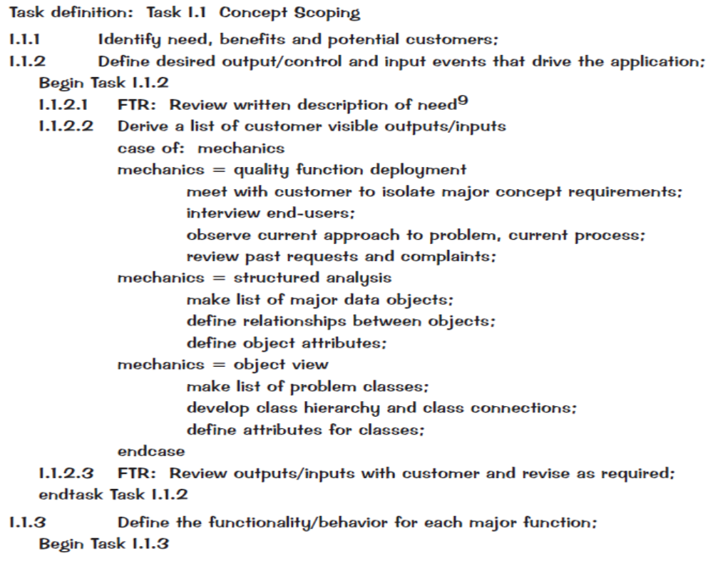

Slide 10
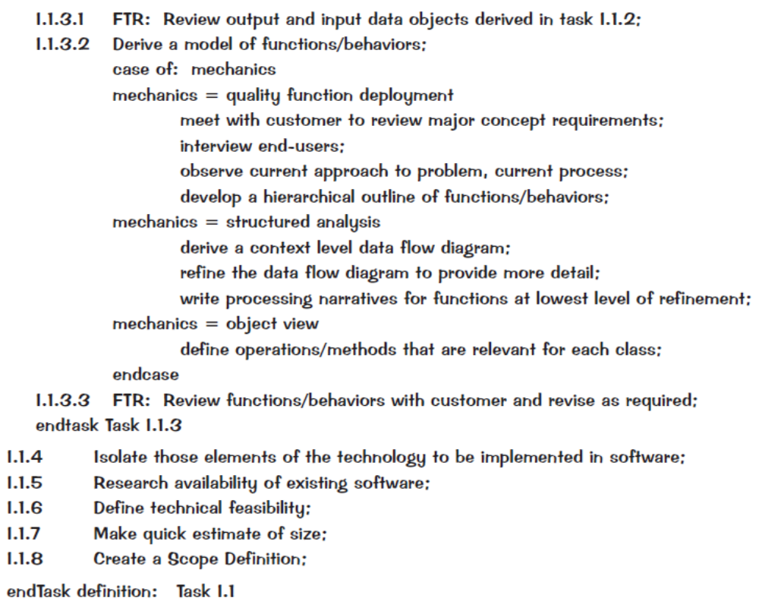

Slide 11
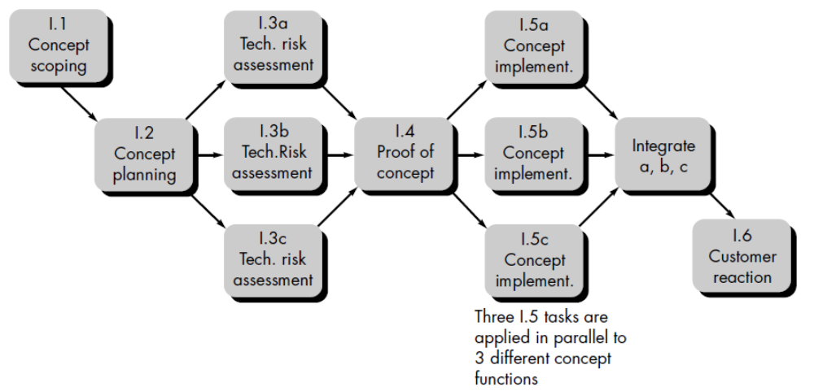
DEFINING A TASK NETWORK
A task network, also called an activity network, is a graphic representation of the
task flow for a project. It is sometimes used as the mechanism through which task
sequence and dependencies are input to an automated project scheduling tool.

Slide 12
SCHEDULING
Scheduling of a software project does not differ greatly from scheduling of any multitask engineering effort. Therefore, generalized project scheduling tools and techniques can be applied with little modification to software projects.
Program evaluation and review technique (PERT) and critical path method (CPM) [MOD83] are two project scheduling methods that can be applied to software development.

Slide 13
Both PERT and CPM provide quantitative tools that allow the software planner to
determine the critical path—the chain of tasks that determines the duration of the project;
(2) establish “most likely” time estimates for individual tasks by applying statistical models; and
(3) calculate “boundary times” that define a time "window" for a particular task.
Both PERT and CPM have been implemented in a wide variety of automated tools that are available for the personal computer [THE93]. Such tools are easy to use and make the scheduling methods described previously available to every software project manager.

Slide 14
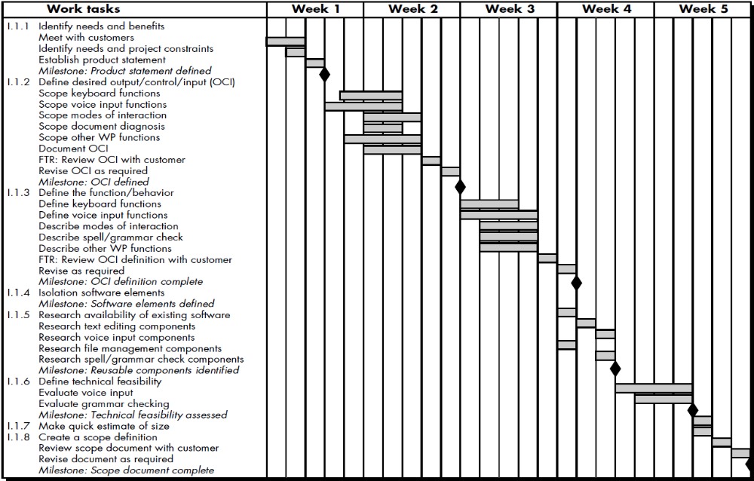
Timeline Charts (An example timeline chart)

Slide 15
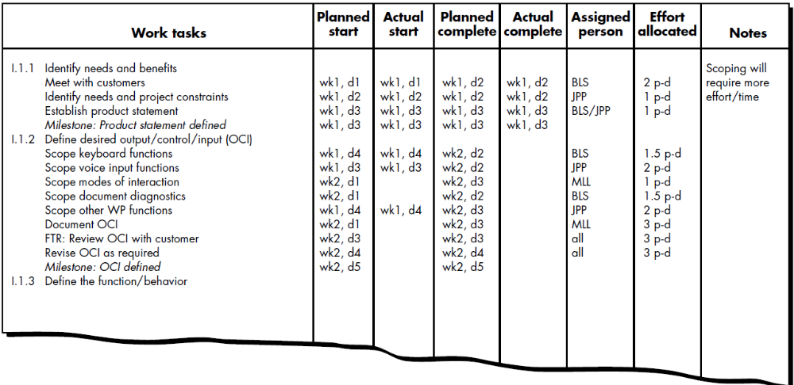
An example project table

Slide 16
Tracking the Schedule
The project schedule provides a road map for a software project manager. If it has been properly developed, the project schedule defines the tasks and milestones that must be tracked and controlled as the project proceeds.

Slide 17
Tracking the Schedule
Tracking can be accomplished in a number of different ways:
Conducting periodic project status meetings in which each team member reports progress and problems.
Evaluating the results of all reviews conducted throughout the software engineering process.
Determining whether formal project milestones (the diamonds shown in Figure have been accomplished by the scheduled date.
Comparing actual start-date to planned start-date for each project task listed in the resource table.
Meeting informally with practitioners to obtain their subjective assessment of progress to date and problems on the horizon.
Using earned value analysis to assess progress quantitatively.

Slide 18
EARNED VALUE ANALYSIS
How do you compute earned value to assess progress?
To determine the earned value, the following steps are performed:
The budgeted cost of work scheduled (BCWS) is determined for each work task represented in the schedule. BCWSi is the effort planned for work task i.
The BCWS values for all work tasks are summed to derive the budget at completion, BAC. Hence,
Next, the value for budgeted cost of work performed (BCWP) is computed. The value for BCWP is the sum of the BCWS values for all work tasks that have actually been completed by a point in time on the project schedule.

Slide 19
Given values for BCWS, BAC, and BCWP, important progress indicators can be computed:
Provides a quantitative indication of the percent of completeness of the project at a given point in time, t. It is also possible to compute the actual cost of work performed, ACWP.
It is then possible to compute:
A CPI value close to 1.0 provides a strong indication that the project is within its
defined budget. CV is an absolute indication of cost savings (against planned costs)
or shortfall at a particular stage of a project.

Slide 20
SUMMARY
Scheduling is the culmination of a planning activity that is a primary component of software project management. When combined with estimation methods and risk analysis, scheduling establishes a road map for the project manager.

